Slide 1
Complex variable, Laplace & Z- transformation
Lecture 06

Slide 2
This Lecture Covers-
Process of Solving Differential Equations using Laplace transformation.
Some Important formulae.
Example and exercises of solving differential equations using Laplace Transformation.

Slide 3
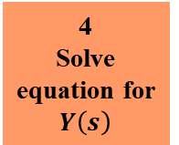
Process of Solving Differential Equations using Laplace Transformation
1
Differential Equation
2
Apply Laplace Transformation
3
Use Initial Values
4
Solve equation for $Y\left(s\right)$
5
Apply Inverse Laplace Transformation

Slide 4
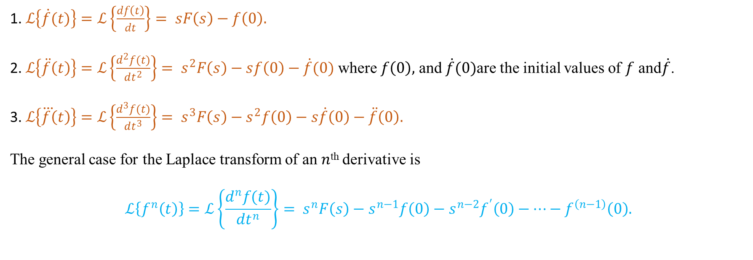
Important Formulae
1. $ℒ\left\{\dot{f}(t)\right\}=ℒ\left\{\frac{df\left(t\right)}{dt}\right\}= sF\left(s\right)−f\left(0\right).$
2. $ℒ\left\{\ddot{f}\left(t\right)\right\}=ℒ\left\{\frac{d^{2}f(t)}{dt^{2}}\right\}= s^{2}F\left(s\right)−sf\left(0\right)−\dot{f}(0)$ where $f\left(0\right),$ and $\dot{f}(0)$are the initial values of $f$ and$\dot{f}$.
3. $ℒ\left\{\overset{⃛}{f}\left(t\right)\right\}=ℒ\left\{\frac{d^{3}f(t)}{dt^{3}}\right\}= s^{3}F\left(s\right)−s^{2}f\left(0\right)−s\dot{f}\left(0\right)−\ddot{f}\left(0\right).$
The general case for the Laplace transform of an $n$^{th} derivative is
$$ℒ\left\{f^{n}\left(t\right)\right\}=ℒ\left\{\frac{d^{n}f(t)}{dt^{n}}\right\}= s^{n}F\left(s\right)−s^{n−1}f\left(0\right)−s^{n−2}f^{′}\left(0\right)−…−f^{\left(n−1\right)}\left(0\right).$$

Slide 5
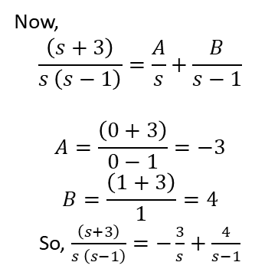
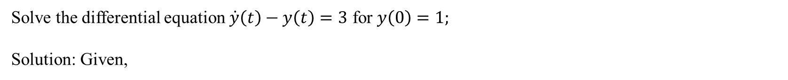
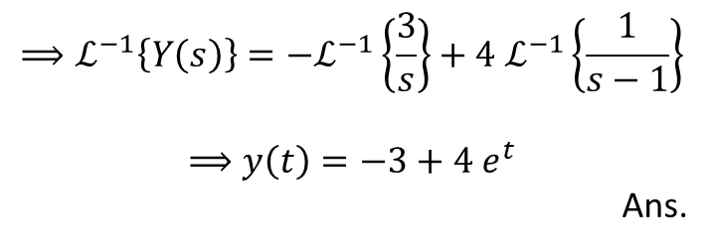
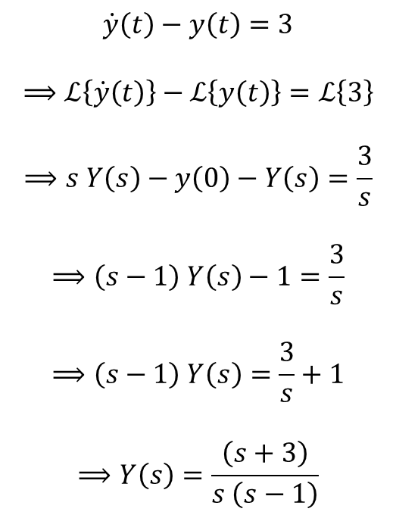
Examples
Solve the differential equation $\dot{y}\left(t\right)−y\left(t\right)=3$ for $y\left(0\right)=1;$
Solution: Given,
$$\dot{y}\left(t\right)−y\left(t\right)=3$$
$$⟹ℒ\left\{\dot{y}\left(t\right)\right\}−ℒ\left\{y\left(t\right)\right\}=ℒ\left\{3\right\}$$
$$⟹s Y\left(s\right)−y\left(0\right)−Y\left(s\right)=\frac{3}{s}$$
$$⟹\left(s−1\right) Y\left(s\right)−1=\frac{3}{s}$$
$$⟹\left(s−1\right) Y\left(s\right)=\frac{3}{s}+1$$
$$⟹Y\left(s\right)=\frac{\left(s+3\right)}{s \left(s−1\right)}$$
$$⟹ℒ^{−1}\left\{Y\left(s\right)\right\}=−ℒ^{−1}\left\{\frac{3}{s}\right\}+4 ℒ^{−1}\left\{\frac{1}{s−1}\right\}$$
$$⟹y\left(t\right)=−3+4 e^{t}$$
Ans.
Now,
$$\frac{\left(s+3\right)}{s \left(s−1\right)}=\frac{A}{s}+\frac{B}{s−1}$$
$$A=\frac{\left(0+3\right)}{0−1}=−3$$
$$B=\frac{\left(1+3\right)}{1}=4$$
So, $\frac{\left(s+3\right)}{s \left(s−1\right)}=−\frac{3}{s}+\frac{4}{s−1}$

Slide 6
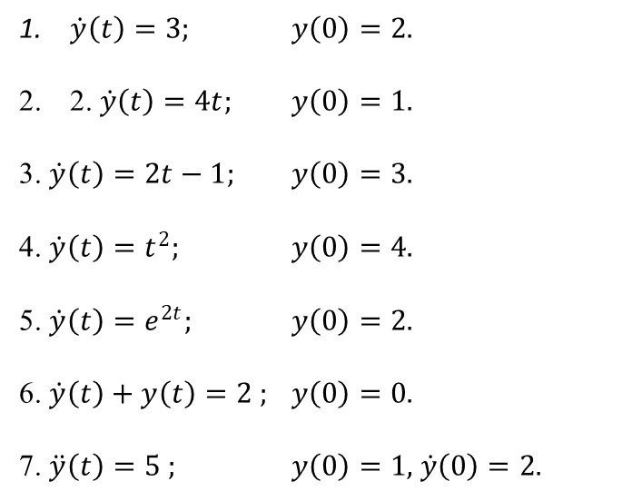

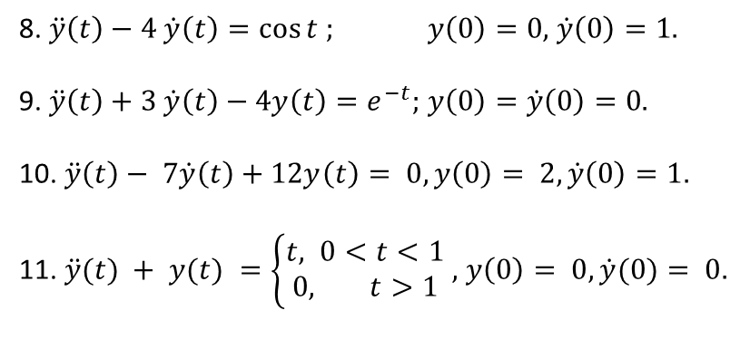
Exercise
Apply Laplace transform to solve the following ordinary differential equations and hence justify your answer, where $\dot{y}≡\frac{dy(t)}{dt}$ and $\ddot{y}≡\frac{d^{2}y(t)}{dt^{2}}$ :
$\dot{y}\left(t\right)=3;$ $y\left(0\right)=2.$
2. $\dot{y}\left(t\right)=4t;$ $y\left(0\right)=1.$
3. $\dot{y}\left(t\right)=2t−1;$ $y\left(0\right)=3.$
4. $\dot{y}\left(t\right)=t^{2};$ $y\left(0\right)=4.$
5. $\dot{y}\left(t\right)=e^{2t};$ $y\left(0\right)=2.$
6. $\dot{y}\left(t\right)+y\left(t\right)=2 ;$ $y\left(0\right)=0.$
7. $\ddot{y}\left(t\right)=5 ;$ $y\left(0\right)=1,$ $\dot{y}\left(0\right)=2.$
8. $\ddot{y}\left(t\right)−4 \dot{y}\left(t\right)=\cos{t ;}$ $y\left(0\right)=0,$ $\dot{y}\left(0\right)=1.$
9. $\ddot{y}\left(t\right)+3 \dot{y}\left(t\right)−4y\left(t\right)=e^{−t};$ $y\left(0\right)=\dot{y}\left(0\right)=0.$
10. $\ddot{y}\left(t\right)− 7\dot{y}\left(t\right)+12y\left(t\right)= 0, y\left(0\right)= 2, \dot{y}\left(0\right)=1.$
11. $\ddot{y}(t) + y(t) =\left\{\begin{aligned}t, 0<t<1 \\ 0, t>1\end{aligned}\right.$ $,$ $y\left(0\right)= 0, \dot{y}(0)= 0.$

Slide 7
Learning Outcomes
After completing this lecture student will learn solving differential equation using Laplace transformation.

Slide 8










Sample MCQ
For $\dot{y}\left(t\right)=3t ; y\left(0\right)=2$ answer the following questions:
1. What is the Laplace transformation of given differential equation?
(a) $sY\left(s\right)−y\left(0\right)$
(b) $sY\left(s\right)−2$
(c) Only a
(d) Both a and b
2. Which one of the following is the term of $Y\left(s\right)$ for given differential equation?
(a) $\frac{1}{s^{3}}+\frac{2}{s}$
(a) $\frac{3}{s^{3}}+\frac{1}{s}$
(a) $\frac{3}{s^{3}}+\frac{2}{s}$
(a) $\frac{3}{s^{3}}−\frac{2}{s}$
3. What is the Inverse Laplace transformation of $Y(s)$ for given differential equation?
(a) $t^{2}+2$
(b) $\frac{3}{2} t^{2}−2$
(c) $\frac{3}{2} t^{2}+2$
(d) $−\frac{3}{2} t^{2}+2$

